Slide 1
TrackTime
Presented By
Team:Octopus
Submitted to:
Alif Ruslan
Lecturer,CSE,UAP

Slide 2
Our Group
Name | ID
Chowdhury Fatmi Monzur Neha | 23201141
Tasnim Ashfaq | 23201154
Farhana Emrose Bintee | 23201158

Slide 3
Table of contents
Topic | Slide no
Introduction | 4
ER Diagram | 5
Entity Relationships | 6
Schema Diagram | 7
Entity Attributes | 8
Tables | 9 - 12
Queries and Outputs | 13 - 20
Conclusion | 21

Slide 4
Introduction
TrackTime is a database management system designed to efficiently monitor and manage metro train operations.
It focuses on organizing train schedules, tracking delays, and delivering real-time passenger notifications, ensuring commuters stay informed and experience smooth, reliable travel.

Slide 5
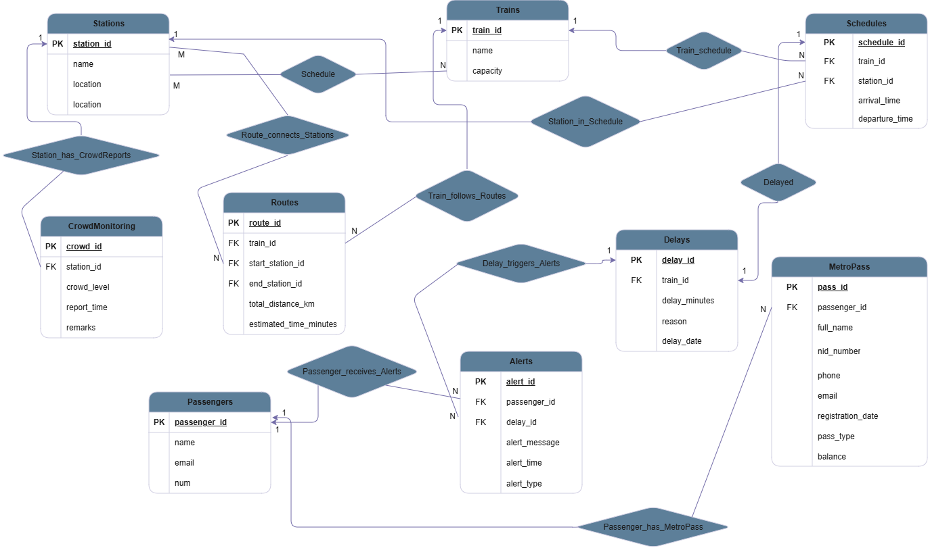
E
R
D
I
A
Gr
A
M

Slide 6
Entity Relationships
Train_schedule: Train → Schedule : (One-to-Many) → A train can have many schedules, but each schedule belongs to only one train.
Station_in_Schedule: Station → Schedule : (One-to-Many) → A station can appear in multiple schedules, while each schedule record refers to one station.
Train_follows_Routes: Train → Route : (One-to-Many) → A train can follow multiple routes, and each route is assigned to one train.
Delay_triggers_Alerts: Delay → Alerts : (One-to-Many) → A delay can trigger multiple alerts; each alert corresponds to one delay
Passenger_receives_Alerts: Passenger → Alerts : (One-to-Many) → A passenger can receive many alerts, while each alert is sent to one passenger.
Passenger_has_MetroPass: Passenger → MetroPass : (One-to-Many) → A passenger can own multiple metro passes, but each metro pass belongs to one passenger.
Route_connects_Stations: Route – Station : (Many-to-Many) → A route connects multiple stations, and a station can belong to multiple routes.
Station_has_CrowdReports: Station → CrowdMonitoring : (One-to-Many) → A station can have several crowd monitoring reports; each report belongs to one station.
Delayed: Schedule → Delays : (One-to-Many) → A schedule can have multiple delay records, but each delay belongs to one specific schedule/train.
Train ↔ Station (via Schedule) : (Many-to-Many) →A train can stop at many stations, and a station can serve many trains, represented through the Schedule entity.

Slide 7
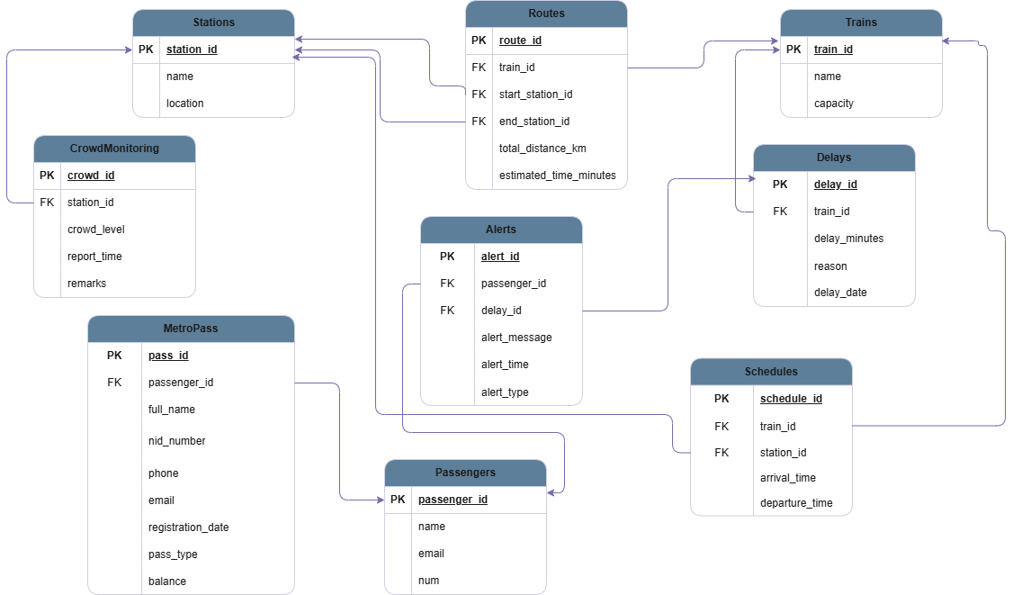
Sc
He
Ma
Di
A
Gr
Am

Slide 8
Entity Attributes
Trains : train_id(PK) , name , capacity
Stations : station_id(PK) , name , location
Passengers : passenger_id(PK) , name , email , num
MetroPass : pass_id(PK) , passenger_id(FK),
Full_name , nid_number , phone , email , registration_date , pass_type , balance
Schedules : schedule_id(PK) , train_id(FK) , station_id(FK) , arrival_time,departure_time
Delays : delay_id(PK) , schedule_id(FK) , delay_minutes,reason , delay_date
Alerts : alert_id(PK),passenger_id(FK) , delay_id(FK) , alert_message,alert_time , alert_type
CrowdMonitoring : crowd_id(PK), station_id(FK) , crowd_level , report_time , remarks
Routes : route_id(PK) , train_id(FK) , start_station_id(FK),
end_station_id(FK) , total_distance_km , estimated_time_minutes

Slide 9
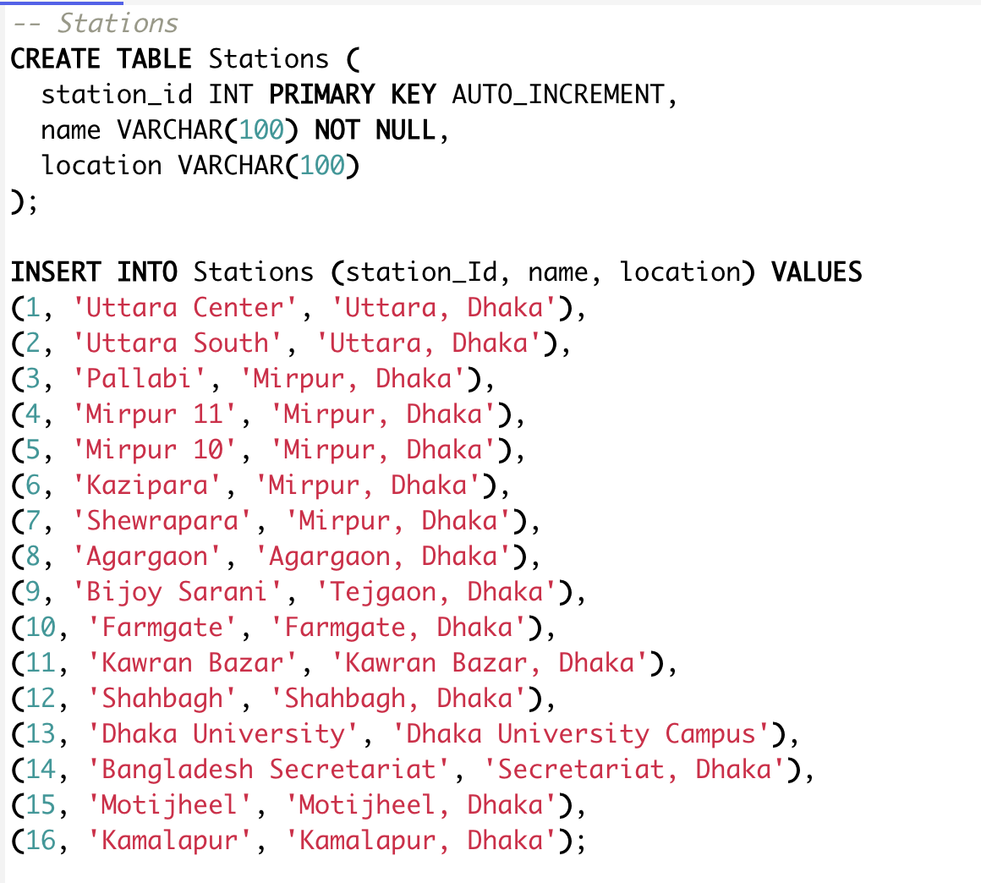
Tables

Slide 10
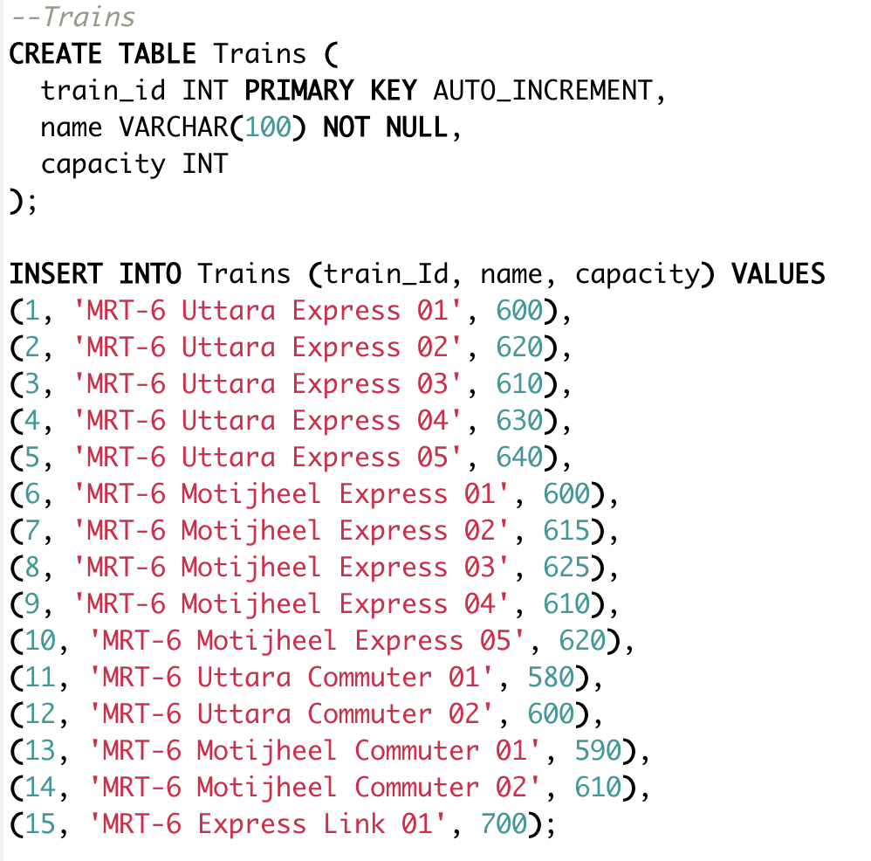

Slide 11
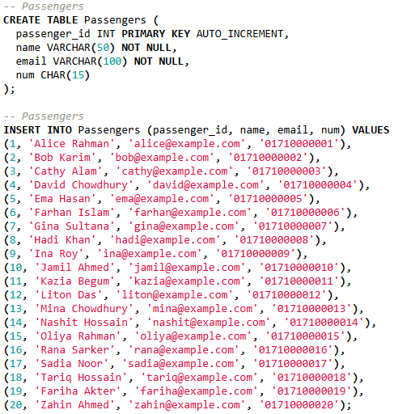

Slide 12
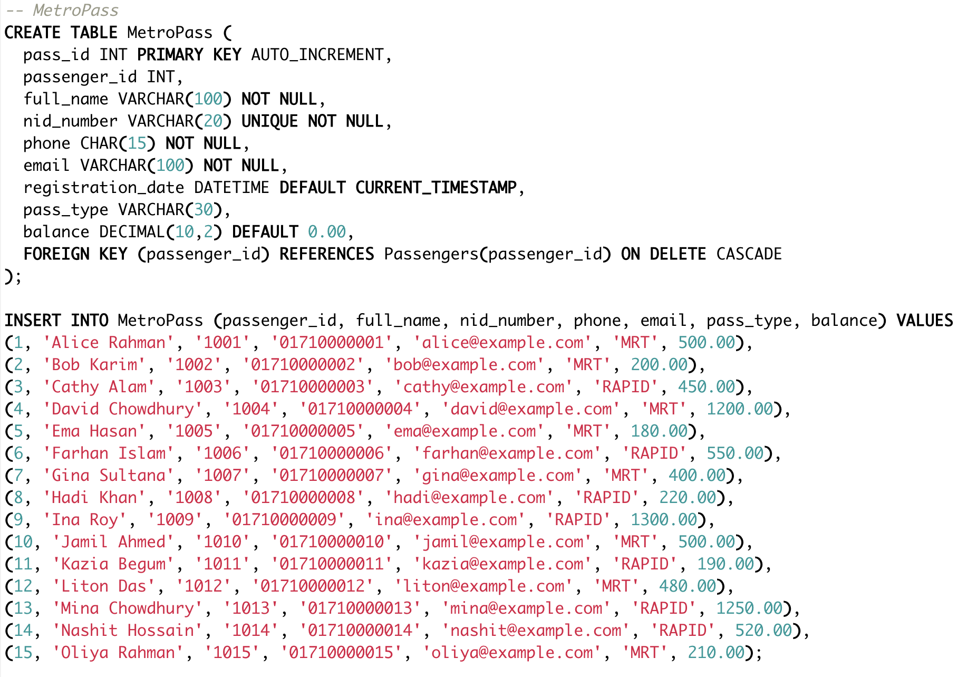

Slide 13
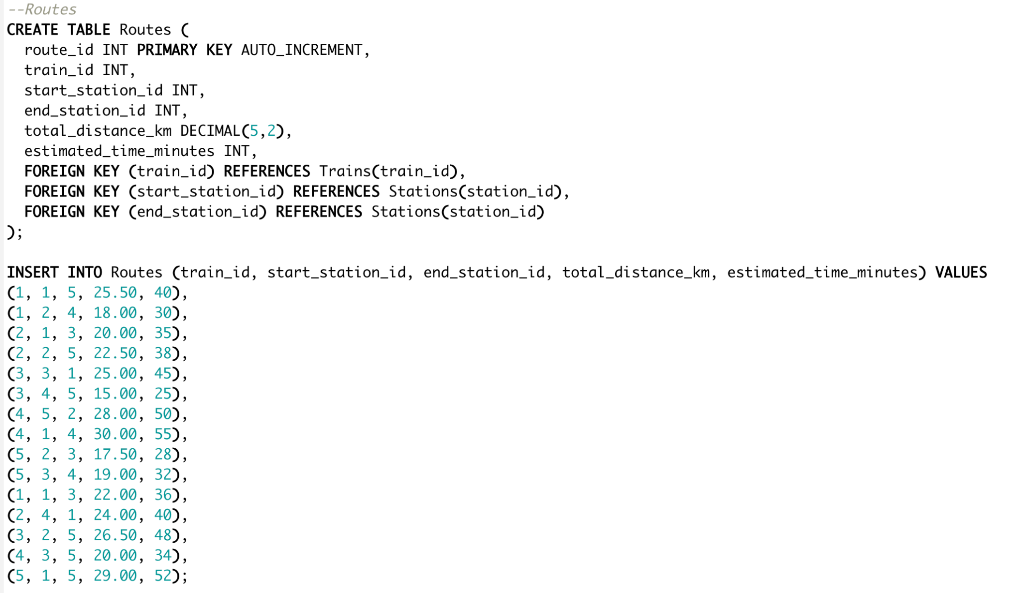

Slide 14
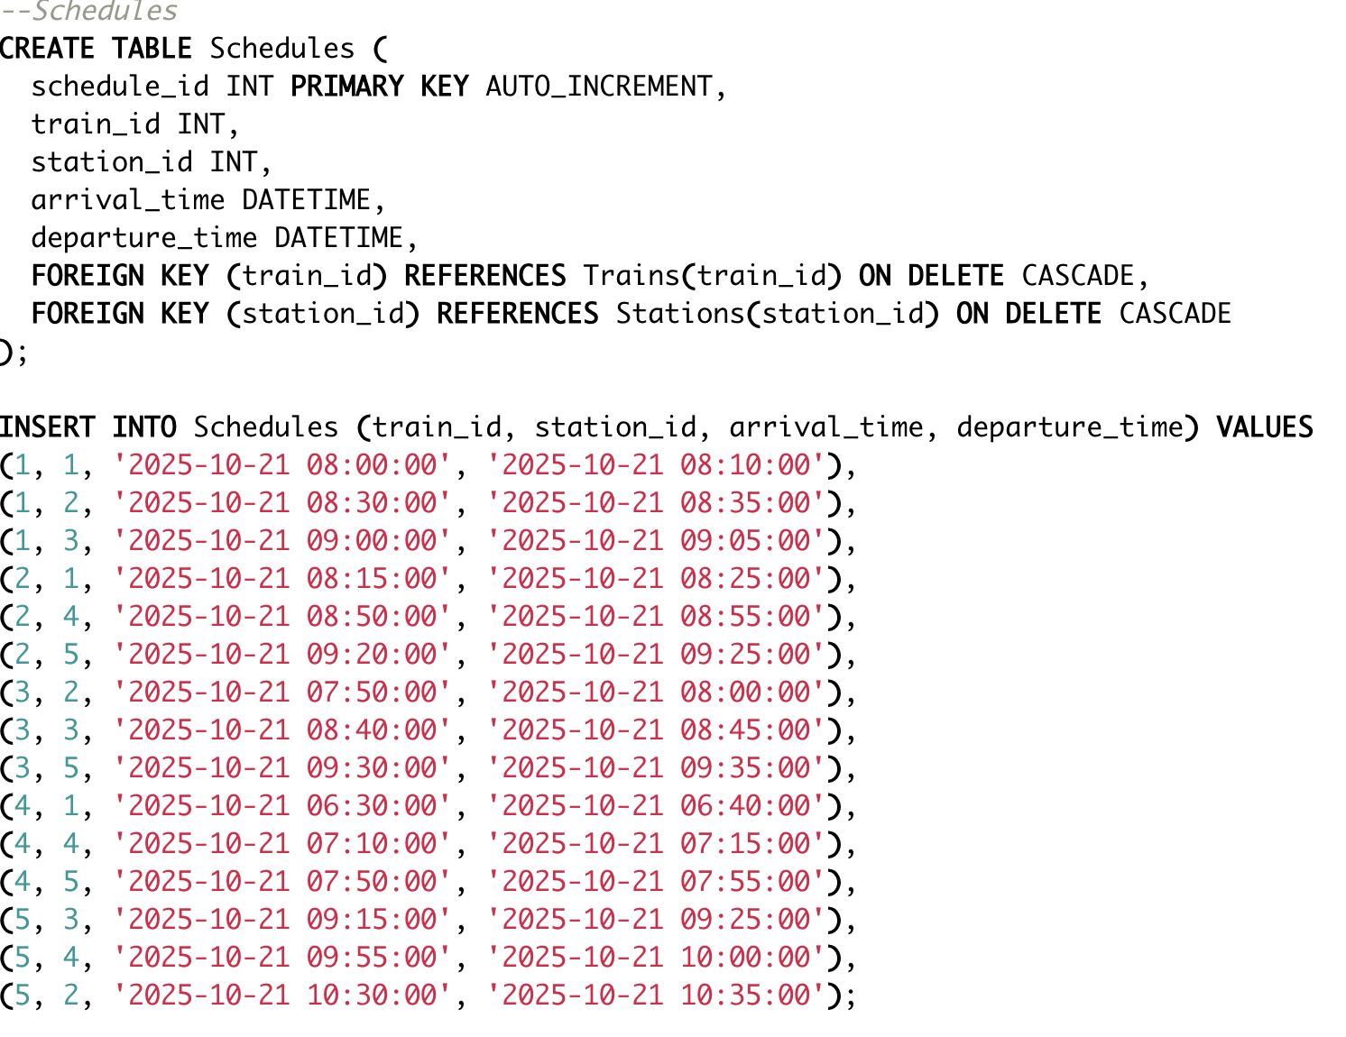

Slide 15
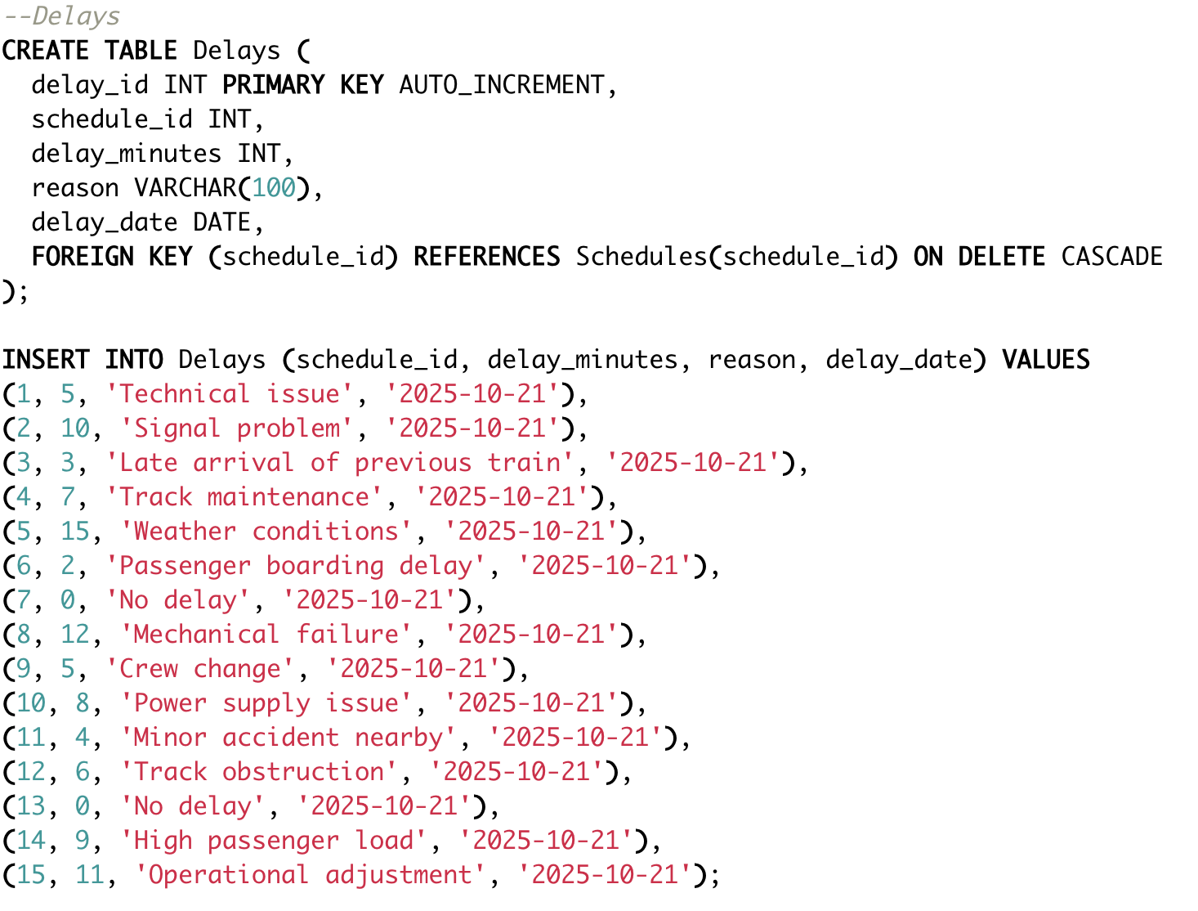

Slide 16
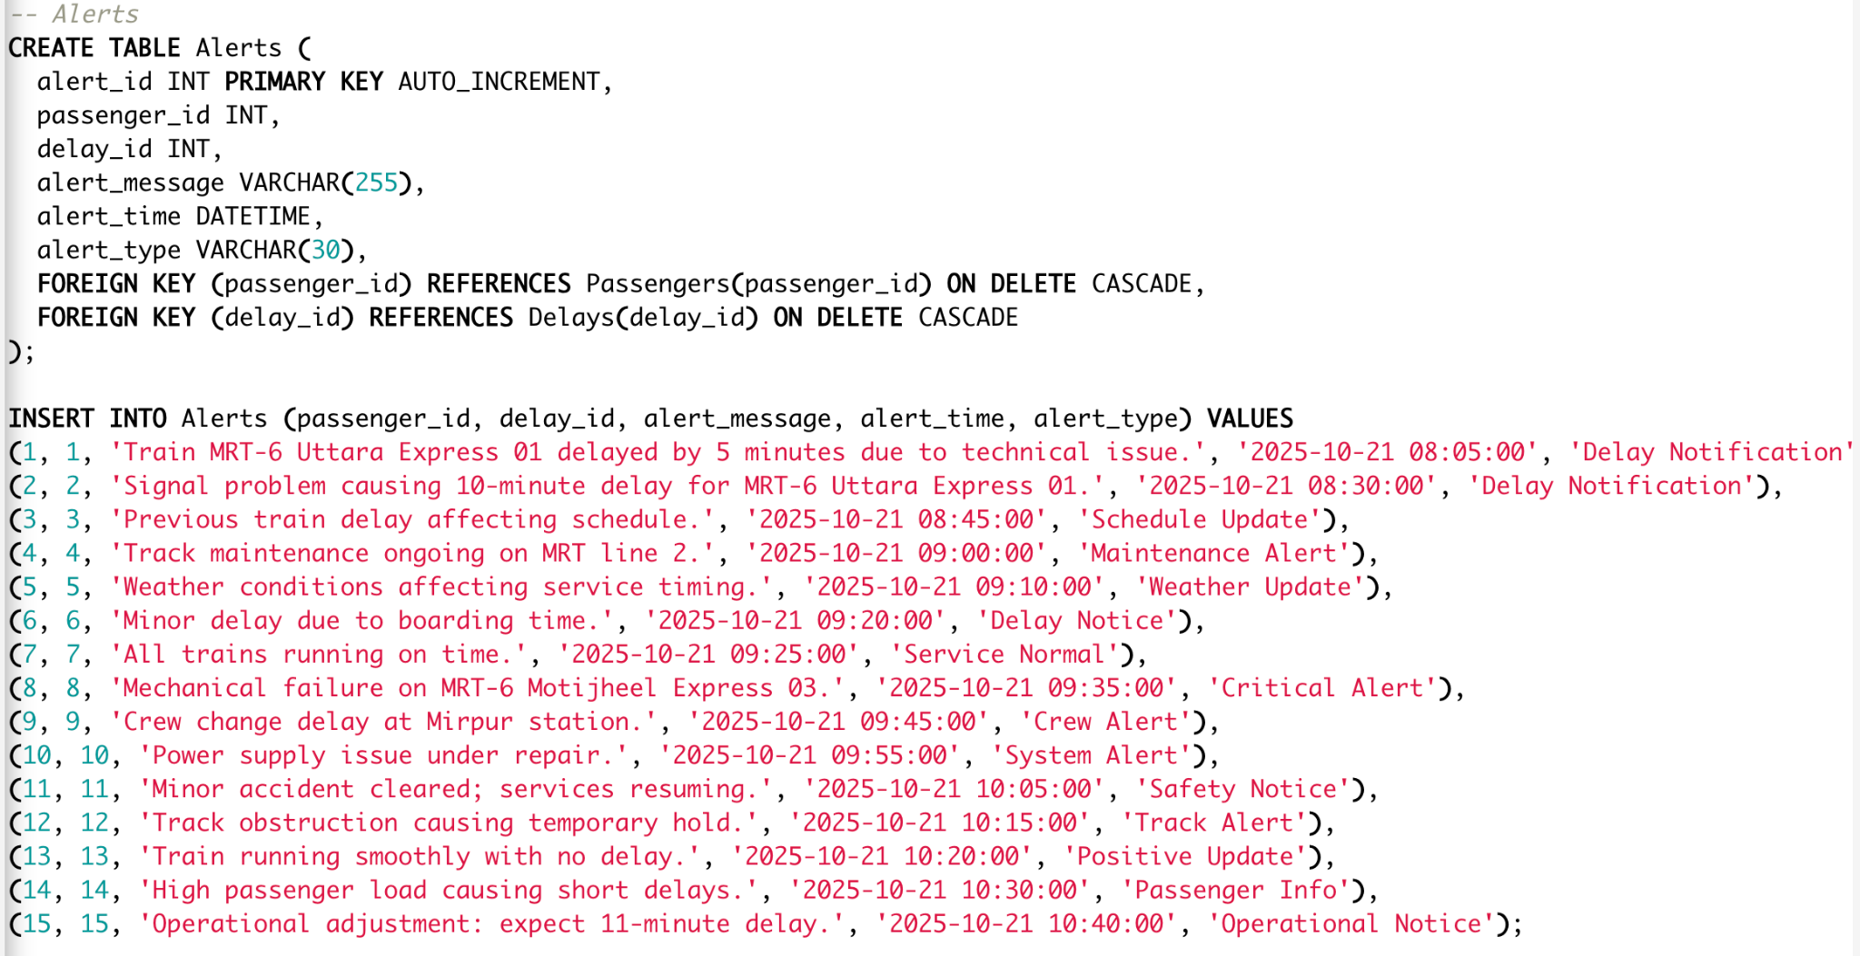

Slide 17
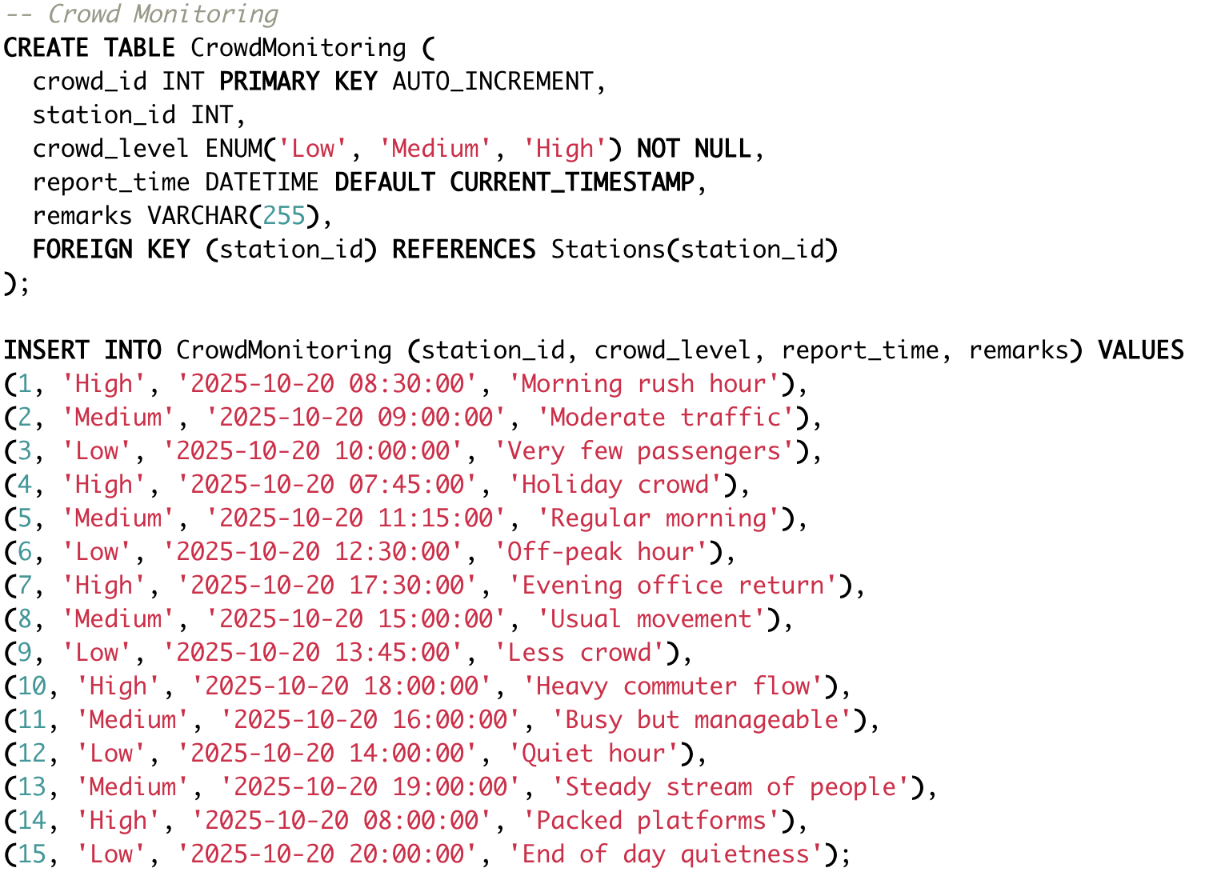

Slide 18
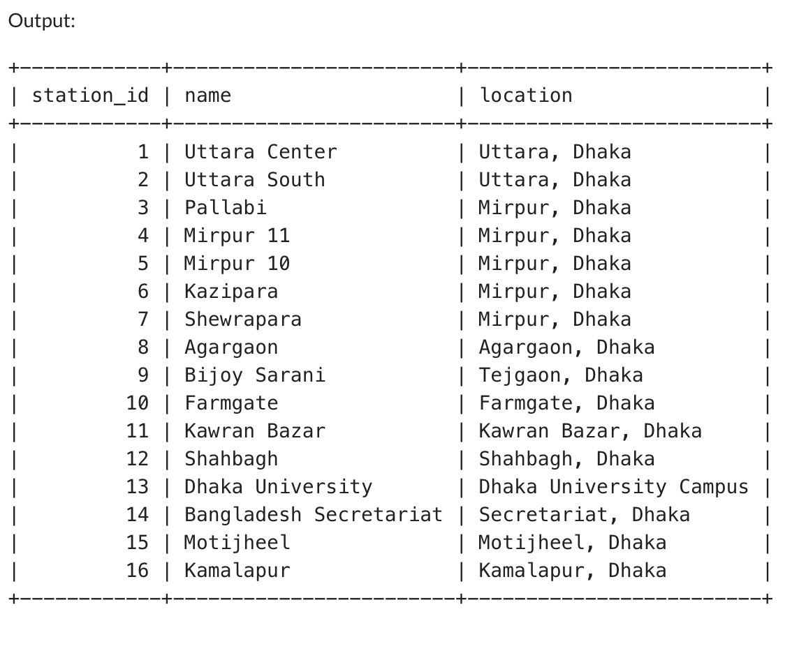
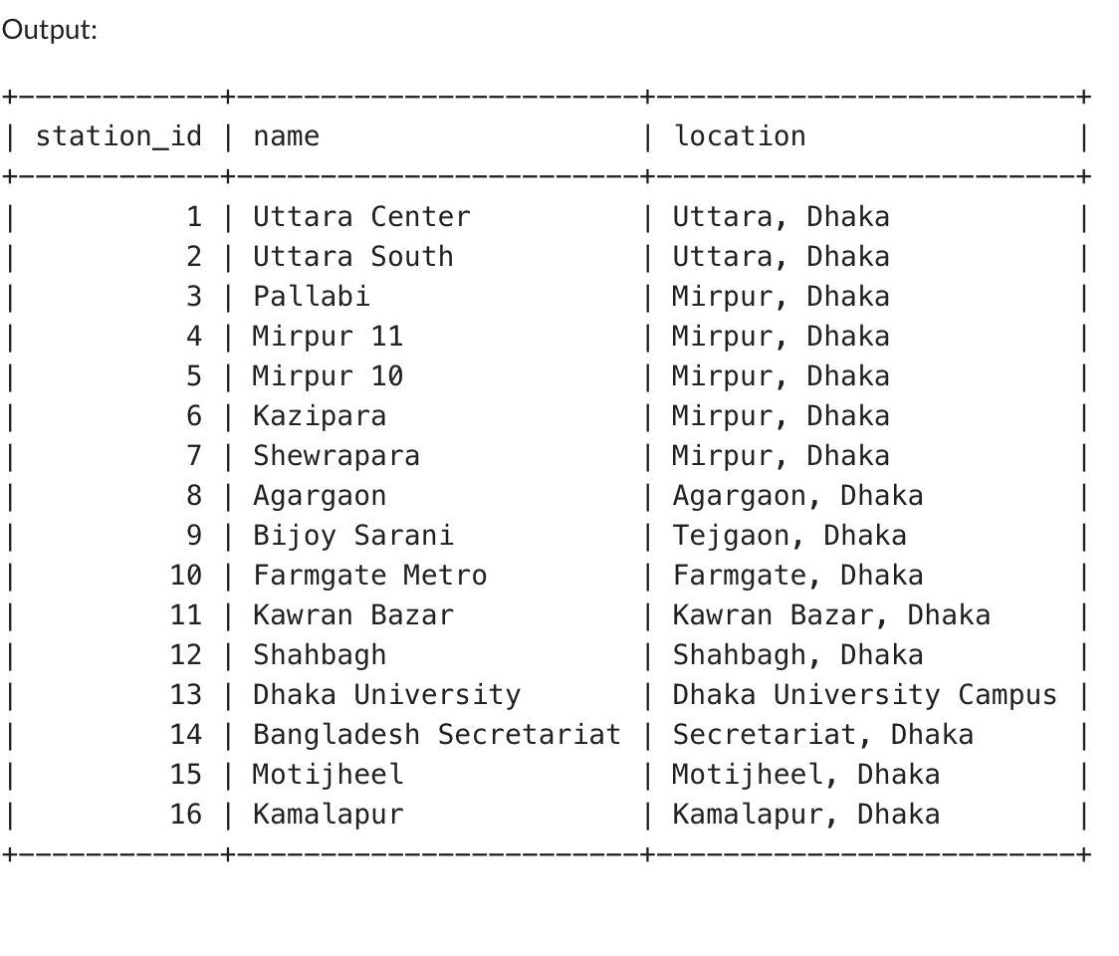
Queries and Outputs
SELECT * FROM Stations;
UPDATE Stations
SET name = 'Farmgate Metro'
WHERE name = 'Farmgate';
SELECT * FROM Stations;

Slide 19
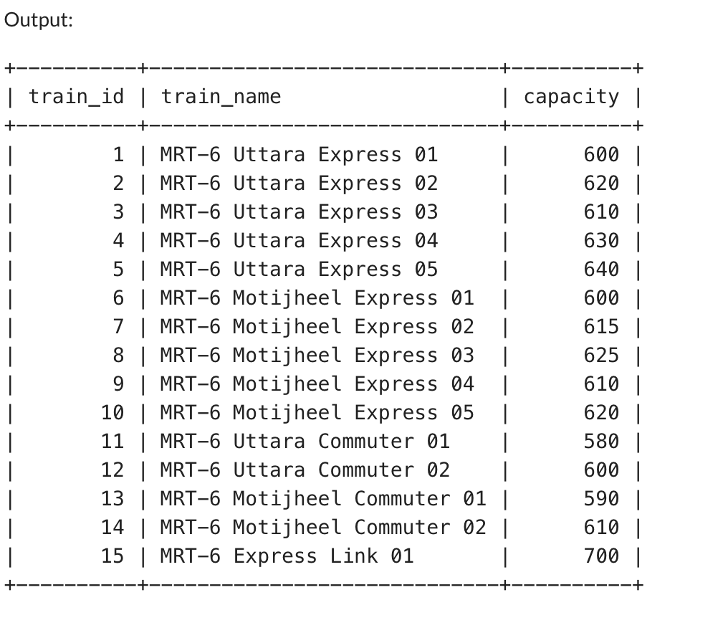
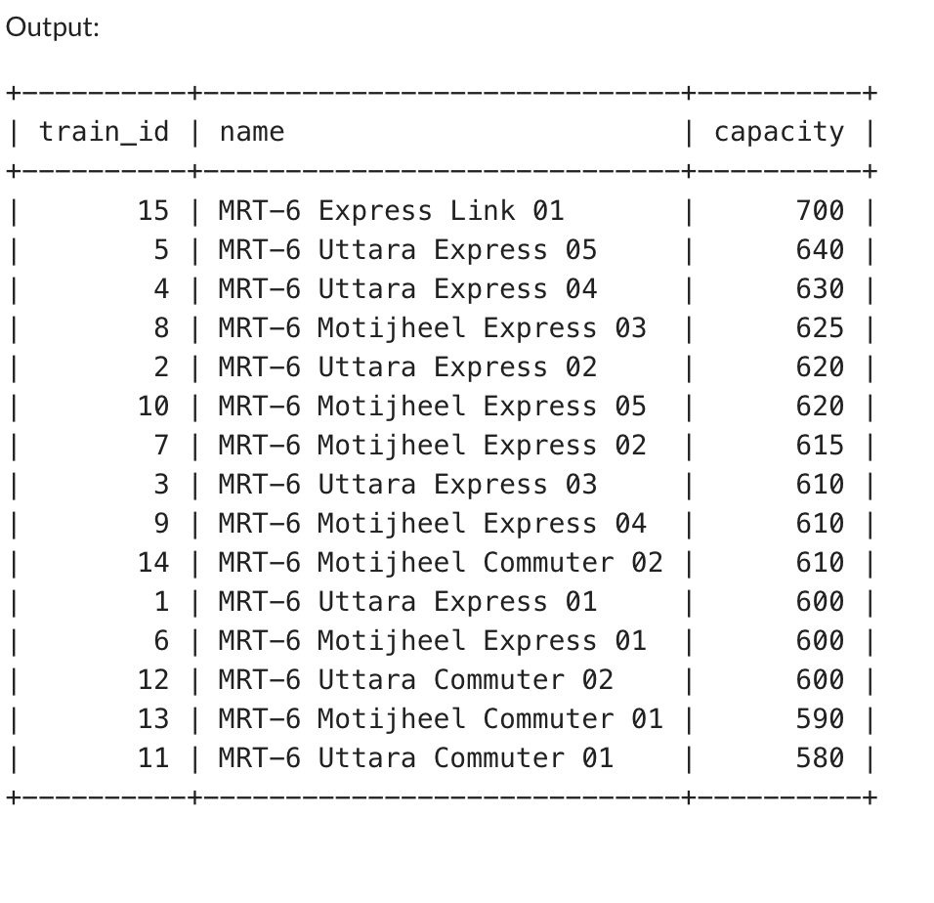
ALTER TABLE Trains
RENAME COLUMN name TO train_name;
SELECT * FROM Trains;
SELECT * FROM Trains
ORDER BY capacity DESC;

Slide 20
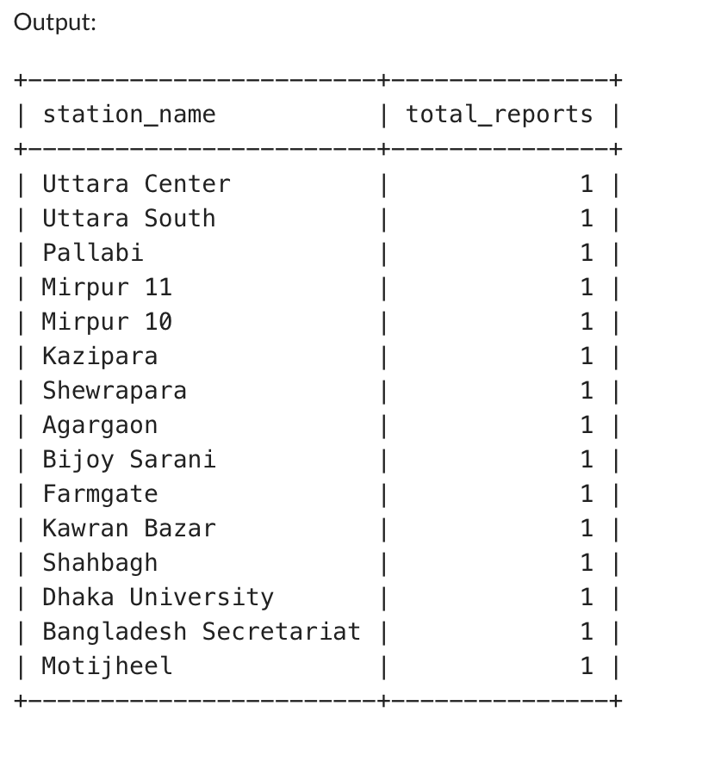
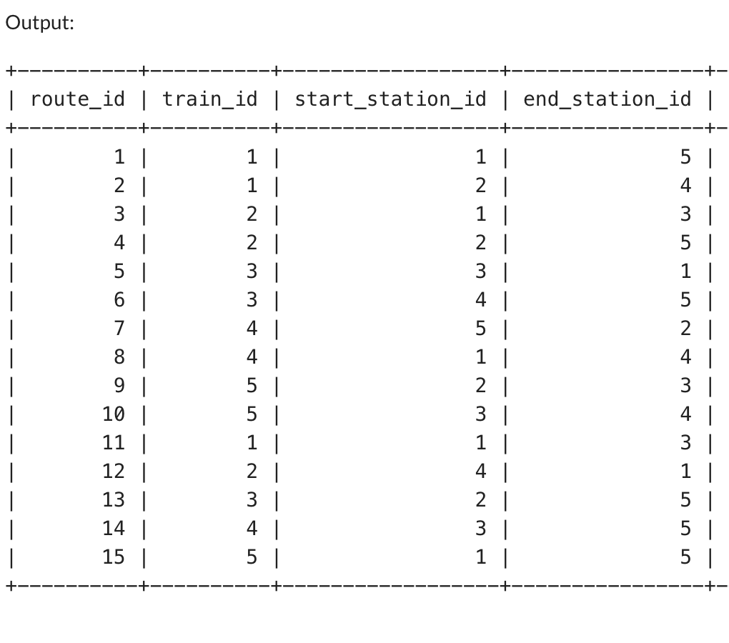
SELECT s.name AS station_name, COUNT(c.crowd_id) AS total_reports
FROM CrowdMonitoring c
JOIN Stations s ON c.station_id = s.station_id
GROUP BY s.name;
SELECT * FROM Routes;

Slide 21
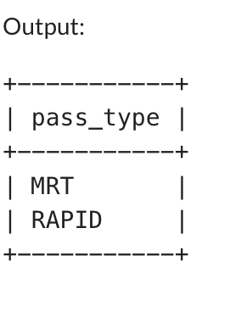
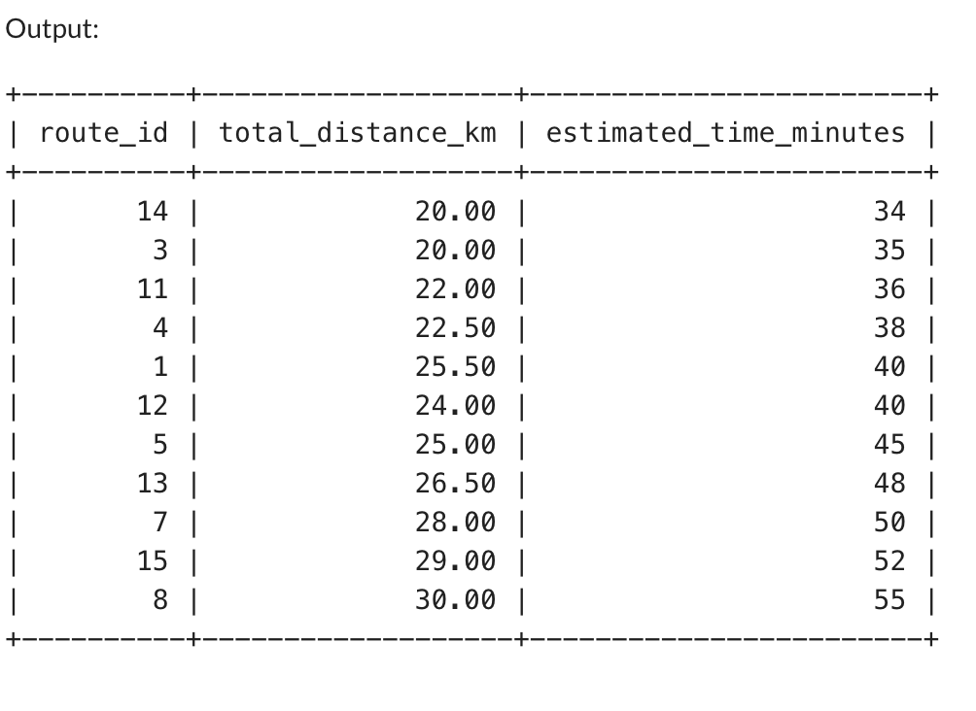
SELECT DISTINCT pass_type
FROM MetroPass
LIMIT 2;
SELECT route_id, total_distance_km, estimated_time_minutes
FROM Routes
WHERE total_distance_km BETWEEN 20 AND 30
ORDER BY estimated_time_minutes ASC;

Slide 22
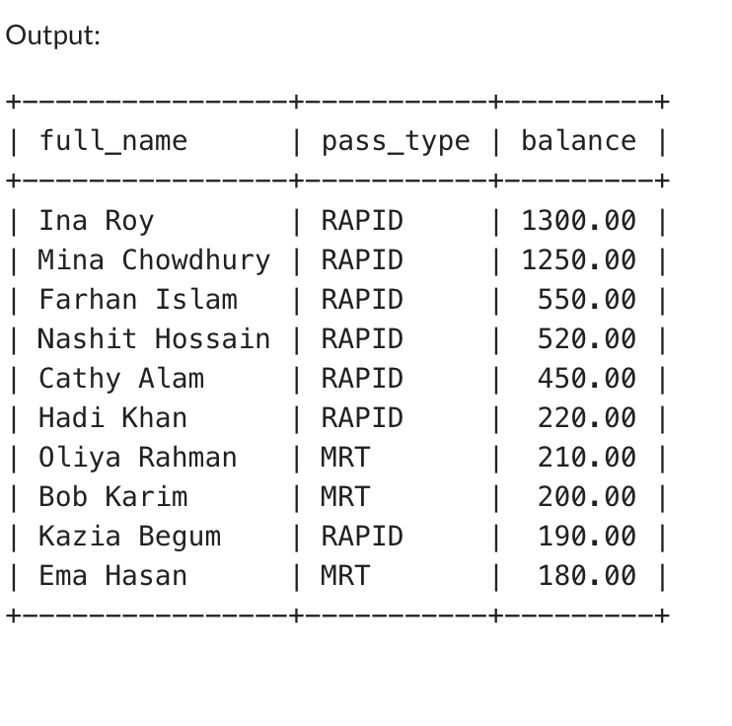
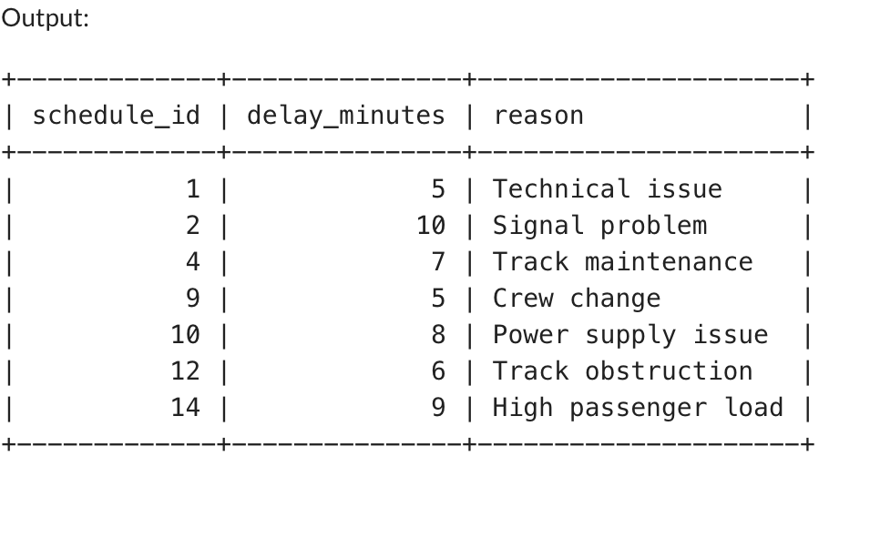
SELECT full_name, pass_type, balance
FROM MetroPass
WHERE balance < 300 OR pass_type = 'RAPID'
ORDER BY balance DESC;
SELECT s.schedule_id, d.delay_minutes, d.reason
FROM Schedules s
JOIN Delays d ON s.schedule_id = d.schedule_id
WHERE d.delay_minutes BETWEEN 5 AND 10;

Slide 23
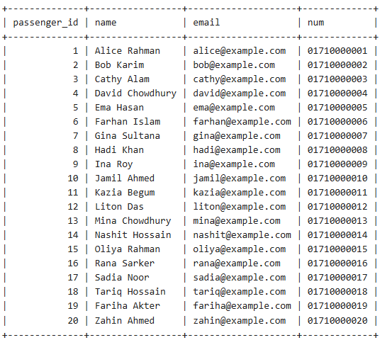
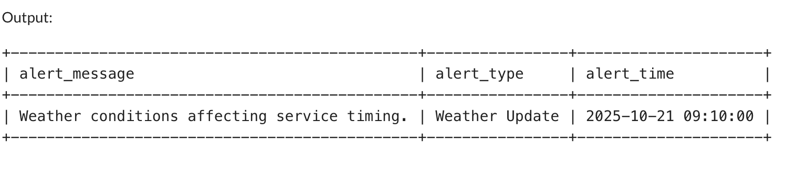
select * from Passengers;
select alert_message,alert_type,alert_time
from Alerts where passenger_id=5;

Slide 24
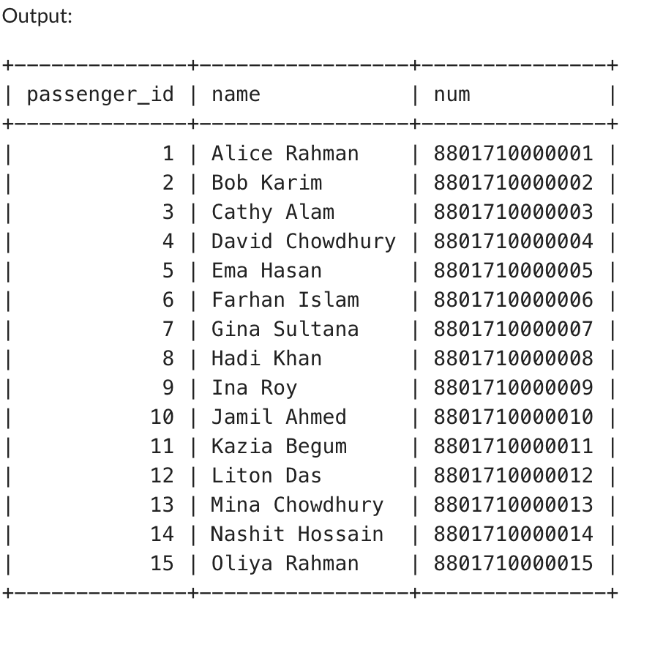
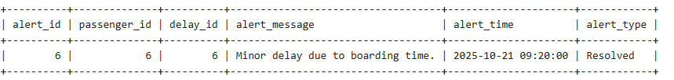
UPDATE Passengers
SET num = CONCAT('88', num)
WHERE num LIKE '0171%';
select passenger_id,name,num from Passengers;
UPDATE Alerts
SET alert_type = 'Resolved'
WHERE alert_type = 'Delay Notice';
select * FROM Alerts WHERE alert_type = 'Resolved';

Slide 25
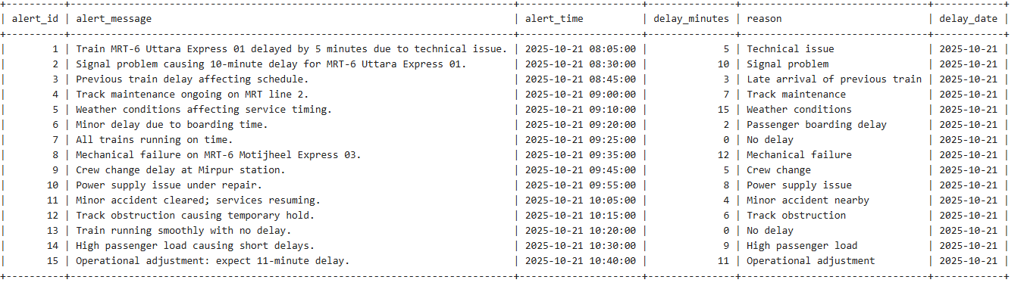
SELECT
a.alert_id,
a.alert_message,
a.alert_time,
d.delay_minutes,
d.reason,
d.delay_date
FROM Alerts a
JOIN Delays d
ON a.delay_id = d.delay_id;

Slide 26
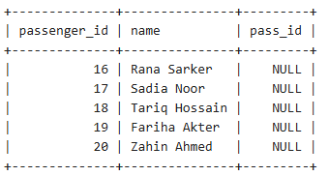
SELECT
p.passenger_id,
p.name,
m.pass_id
FROM Passengers p
left JOIN MetroPass m
ON p.passenger_id=m.passenger_id WHERE m.passenger_id IS NULL;

Slide 27
Conclusion
TrackTime improves metro management by keeping schedules accurate and delays well-monitored. The system strengthens communication with passengers through real-time alerts, ensuring a smoother and more reliable travel experience across the metro network.

Slide 28
Resources
Github link
ER Diagram
Schema Diagram

Slide 29
THANKS!!

Slide 30
এবার থামুন!!!

